Slide 1
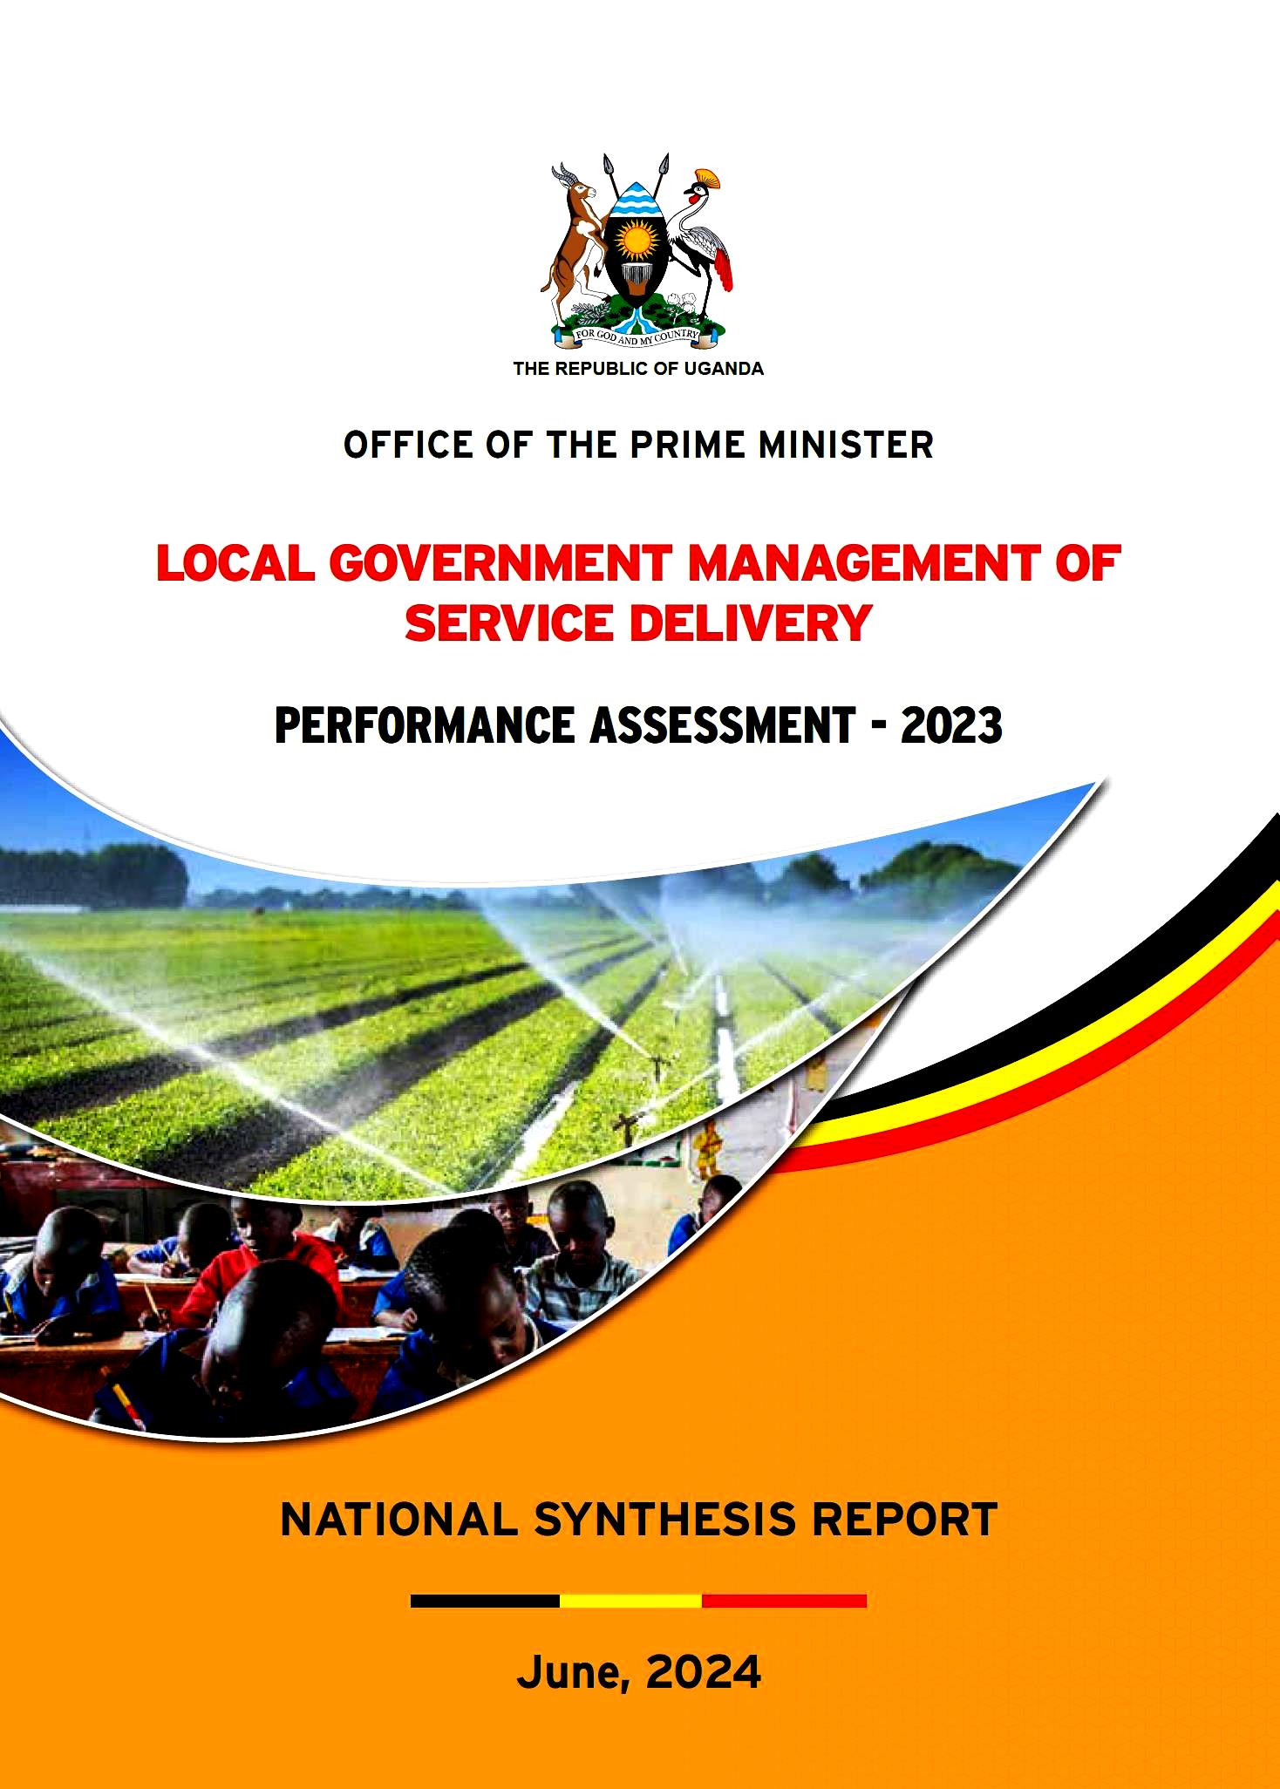
LOCAL GOVERNMENT MANAGEMENT OF SERVICE DELIVERY (LGMSD)
2023 ASSESSMENT RESULTS
Makindye-Ssabagabo MC
13th August, 2024

Slide 2
LGMSD PA Goal & Objectives
GOAL:
To promote effective behavior, systems and procedures in order to improve Local Governments’ Administration and Service Delivery.
OBJECTIVE 01:
Incentivize and promote good practice in administration, resource management, accountability and Service Delivery
OBJECTIVE 02:
Identification of Local Government functional capacity gaps and needs for performance improvement
OBJECTIVE 03:
Contribute to general Monitoring and Evaluation system in Local Governments for making management decisions

Slide 3
LGMSD PA Scope and Methodology
Level | Scope | No. Assessed | Assessed Areas | Assessment Methodology
HLG | District Local Gov’ts | 135 | Crosscutting, Education, Health, Water & Environment and Micro-Scale Irrigation | Independent Assessment & IVA firms
 | Cities | 10
 | Municipal Councils | 31
LLGs | All LLGs across all Cities, MLGs & DLGs (except KCCA) | 1,496 | PDM Structures, Planning & Budgeting, OSR, HRM, PHC services, Primary Education, Production, etc | LG Staff & Assessment firms
Facilities | All Local Governments | 176 | Primary Schools and Health Facilities (HC IIIs and IVs) | LG Staff & Assessment firms
CG | Line MDAs (OPM, MoFPED, MoLG, MoES, MoH, MoWE, MAAIF, MoWT, OAG, PPDA & NEMA) | 11 | Disbursement Linked Indicators by the World Bank | IVA firm

Slide 4
Scoring & Allocation formulae – LGMSD 2023
Overall score (%) = (Minimum Conditions) x (Performance Measures)
100
MCs Score (%) | PMS Score | Overall Score (%)
100 | 70 | 70
75 | 70 | 52.5
50 | 70 | 35
25 | 70 | 17.5
0 | 70 | 0
Overall score is then weighted with the basic formula as follows:
Component 1: Allocation drawn on a need-based formula:
Component 2: Allocation based on the performance assessment results computed as:
Grant | Core minimum allocations | Basic Formula (%) | Performance element (%)
DDEG | N/A | 50 | 50
Education | Cost for construction of Sec. school | 50 | 50
Health | Costs for up-grading of HC II to III | 0 | 100
Water and Environment | N/A | 50 | 50
Micro-scale Irrigation | N/A | 60 | 40

Slide 5
Trends in performance (last 2 Yrs) – Makindye-Ssabagabo MC
 |  | LGMSD Score |  | LGMSD Rank
No. | Area of Assessment | 2022 | 2023 | 2022 | 2023 | Trend based on Ranking
1. | Overall Score & Ranking | 52% | 68% | 71 | 47
2. | Cross Cutting | 64% | 73% | 14 | 20
3. | Education | 63% | 87% | 68 | 16
4. | Health | 28% | 43 | 137 | 127
5. | Water and Environment | N/A | N/A | N/A | N/A | N/A
6. | Micro-Scale Irrigation | N/A | N/A | N/A | N/A | N/A

Slide 6
Makindye- Ssabagabo MC 2023 performance by Assessment Area
Education had highest score with 87% overall, compared to the national average of 65%.
Lowest score was under Health (43%) as compared to national average of 54%

Slide 7
LGMSDA impact on Grant allocations (2024/25)
 | EDUCATION |  | HEALTH |  | WATER |  | DDEG |  | AGRICULTURE
District | Without incentive | With Incentive | Without Incentive | With Incentive | Without Incentive | With Incentive | Without incentive | With Incentive | Without incentive | With Incentive
Jinja city | 160,963,074 | 152,856,576 | 106,377,257 | 115,271,314 | 0 | 0 | 0 | 0 | 0 | 0
Entebbe Municipal Council | 94,058,768 | 120,836,250 | 194,058,350 | 283,300,842 | 0 | 0 | 0 | 0 | 0 | 0
Kira Municipal Council | 250,401,584 | 330,933,334 | 373,525,291 | 527,376,059 | 0 | 0 | 606,439,122 | 672,629,834 | 0 | 0
Lugazi Municipal Council | 109,173,577 | 95,593,226 | 203,649,686 | 120,625,637 | 0 | 0 | 0 | 0 | 0 | 0
Makindye-Ssabagabo Municipal Council | 236,652,233 | 308,368,158 | 339,750,656 | 255,585,158 | 0 | 0 | 602,900,225 | 606,521,803 | 0 | 0
Mukono Municipal Council | 123,715,066 | 147,975,388 | 133,144,398 | 175,698,366 | 0 | 0 | 238,177,379 | 207,376,160 | 0 | 0
Nansana Municipal Council | 308,250,345 | 358,232,375 | 246,413,736 | 397,025,532 | 0 | 0 | 741,480,715 | 848,073,835 | 0 | 0
Njeru Municipal Council | 130,548,052 | 167,713,625 | 114,025,173 | 74,413,904 | 0 | 0 | 273,925,380 | 277,182,552 | 0 | 0
Buikwe District | 324,533,721 | 243,593,522 | 65,620,780 | 73,122,527 | 327,337,801 | 308,496,603 | 183,471,049 | 194,430,599 | 339,287,410 | 365,973,045
Buvuma District | 278,548,443 | 305,509,745 | 88,444,956 | 75,956,682 | 572,782,293 | 650,442,226 | 179,888,632 | 188,434,155 | 338,378,618 | 341,519,499
Jinja District | 203,406,090 | 261,313,534 | 105,045,162 | 116,646,113 | 611,145,239 | 726,766,052 | 212,372,781 | 204,038,647 | 458,386,403 | 558,035,810
Kayunga District | 313,426,045 | 374,888,380 | 161,742,875 | 252,244,133 | 854,017,607 | 950,189,197 | 393,827,226 | 506,065,426 | 838,176,728 | 956,430,788
Mukono District | 496,624,246 | 343,931,892 | 156,124,966 | 135,715,867 | 952,356,133 | 1,014,224,306 | 392,613,525 | 389,861,731 | 1,031,412,518 | 812,029,643

Slide 8
Impact on DDEG LG Grant - FY 2024/25
Vote | Formula Based Allocation | Performance Based Allocation | Difference in Allocation | % Gain/Loss
Jinja city | 0 | 0 | 0 | 0%
Entebbe Municipal Council | 0 | 0 | 0 | 0%
Kira Municipal Council | 606,439,122 | 672,629,834 | 66,190,712 | 11%
Lugazi Municipal Council | 0 | 0 | 0 | 0%
Makindye-Ssabagabo Municipal Council | 602,900,225 | 606,521,803 | 3,621,578 | 1%
Mukono Municipal Council | 238,177,379 | 207,376,160 | -30,801,219 | -13%
Nansana Municipal Council | 741,480,715 | 848,073,835 | 106,593,120 | 14%
Njeru Municipal Council | 273,925,380 | 277,182,552 | 3,257,173 | 1%
Buikwe District | 183,471,049 | 194,430,599 | 10,959,550 | 6%
Buvuma District | 179,888,632 | 188,434,155 | 8,545,524 | 5%
Jinja District | 212,372,781 | 204,038,647 | -8,334,134 | -4%
Kayunga District | 393,827,226 | 506,065,426 | 112,238,199 | 28%
Mukono District | 392,613,525 | 389,861,731 | -2,751,794 | -1%

Slide 9
Impact on Educ Dev’t Grant (formerly SFG) FY 2024/25
Vote | Formula Based Allocation | Performance Based Allocation | Difference in Allocation | % Gain/Loss
Jinja city | 160,963,074 | 152,856,576 | -8,106,498 | -5%
Entebbe Municipal Council | 94,058,768 | 120,836,250 | 26,777,482 | 28%
Kira Municipal Council | 250,401,584 | 330,933,334 | 80,531,749 | 32%
Lugazi Municipal Council | 109,173,577 | 95,593,226 | -3,580,351 | -12%
Makindye-Ssabagabo Municipal Council | 236,652,233 | 308,368,157 | 71,715,925 | 30%
Mukono Municipal Council | 123,715,066 | 147,975,388 | 24,260,322 | 20%
Nansana Municipal Council | 308,250,345 | 358,232,375 | 49,982,029 | 16%
Njeru Municipal Council | 130,548,052 | 167,713,625 | 37,165,574 | 28%
Buikwe District | 324,533,721 | 243,593,522 | -80,940,199 | -25%
Buvuma District | 278,548,443 | 305,509,745 | 26,961,302 | 10%
Jinja District | 203,406,090 | 261,313,534 | 57,907,444 | 28%
Kayunga District | 313,426,045 | 374,888,380 | 61,462,334 | 20%
Mukono District | 496,624,246 | 343,931,892 | -152,692,354 | -31%

Slide 10
Impact - Health Dev’t Grant (Formula & Performance) - FY 2024/25
Vote | Formula Based Allocation | Performance Based Allocation | Difference in Allocation | % Gain/Loss
Jinja city | 106,377,257 | 115,271,314 | 8,894,057 | 8%
Entebbe Municipal Council | 194,058,350 | 283,300,842 | 89,242,492 | 46%
Kira Municipal Council | 373,525,291 | 527,376,059 | 153,850,768 | 41%
Lugazi Municipal Council | 203,649,686 | 120,625,637 | -83,024,049 | -41%
Makindye-Ssabagabo Municipal Council | 339,750,656 | 255,585,158 | -84,165,498 | -25%
Mukono Municipal Council | 133,144,398 | 175,698,366 | 42,553,968 | 32%
Nansana Municipal Council | 246,413,736 | 397,025,532 | 150,611,797 | 61%
Njeru Municipal Council | 114,025,173 | 74,413,904 | -39,611,269 | -35%
Buikwe District | 65,620,780 | 73,122,527 | 7,501,748 | 11%
Buvuma District | 88,444,956 | 75,956,682 | -12,488,274 | -14%
Jinja District | 105,045,162 | 116,646,113 | 11,600,951 | 11%
Kayunga District | 161,742,875 | 252,244,133 | 90,501,258 | 56%
Mukono District | 156,124,966 | 135,715,867 | -20,409,099 | -13%

Slide 11
Impact on Water Grant (Rural & Piped Water) FY2024/25
Vote | Formula Based Allocation | Performance Based Allocation | Difference in Allocation | % Gain/Loss
Jinja city | 0 | 0 | 0 | 0%
Entebbe Municipal Council | 0 | 0 | 0 | 0%
Kira Municipal Council | 0 | 0 | 0 | 0%
Lugazi Municipal Council | 0 | 0 | 0 | 0%
Makindye-Ssabagabo Municipal Council | 0 | 0 | 0 | 0%
Mukono Municipal Council | 0 | 0 | 0 | 0%
Nansana Municipal Council | 0 | 0 | 0 | 0%
Njeru Municipal Council | 0 | 0 | 0 | 0%
Buikwe District | 327,337,801 | 308,496,603 | -18,841,197 | -6%
Buvuma District | 572,782,292 | 650,442,226 | 77,659,934 | 14%
Jinja District | 611,145,239 | 726,766,052 | 115,620,812 | 19%
Kayunga District | 854,017,607 | 950,189,197 | 96,171,589 | 11%
Mukono District | 952,356,133 | 1,014,224,306 | 61,868,173 | 6%

Slide 12
Impact on Micro-Scale Irrigation Grant for FY2024/25
Vote | Formula Based Allocation | Performance Based Allocation | Difference in Allocation | % Gain/Loss
Jinja city | 0 | 0 | 0 | 0%
Entebbe Municipal Council | 0 | 0 | 0 | 0%
Kira Municipal Council | 0 | 0 | 0 | 0%
Lugazi Municipal Council | 0 | 0 | 0 | 0%
Makindye-Ssabagabo Municipal Council | 0 | 0 | 0 | 0%
Mukono Municipal Council | 0 | 0 | 0 | 0%
Nansana Municipal Council | 0 | 0 | 0 | 0%
Njeru Municipal Council | 0 | 0 | 0 | 0%
Buikwe District | 339,287,410 | 365,973,045 | 26,685,635 | 8%
Buvuma District | 338,378,618 | 341,519,499 | 3,140,881 | 1%
Jinja District | 458,386,403 | 558,035,810 | 99,649,407 | 22%
Kayunga District | 838,176,728 | 956,430,788 | 118,254,060 | 14%
Mukono District | 1,031,412,518 | 812,029,643 | -219,382,875 | -21%

Slide 13
Impact on Total Grant (DDEG, Educ, Health & Water) - FY2023/24
Vote | Formula Based Allocation | Performance Based Allocation | Difference in Allocation | % Gain/Loss
Jinja city | 267,340,331 | 268,127,890 | 787,559 | 0.3%
Entebbe Municipal Council | 288,117,118 | 404,137,092 | 116,019,974 | 40.3%
Kira Municipal Council | 1,230,365,997 | 1,530,939,226 | 300,573,229 | 24.4%
Lugazi Municipal Council | 312,823,263 | 216,218,864 | -96,604,399 | -30.9%
Makindye-Ssabagabo Municipal Council | 1,179,303,113 | 1,170,475,118 | -8,827,995 | -0.7%
Mukono Municipal Council | 495,036,843 | 531,049,914 | 36,013,071 | 7.3%
Nansana Municipal Council | 1,296,144,796 | 1,603,331,742 | 307,186,946 | 23.7%
Njeru Municipal Council | 518,498,605 | 519,310,082 | 811,477 | 0.2%
Buikwe District | 1,240,250,760 | 1,185,616,296 | -54,634,464 | -4.4%
Buvuma District | 1,458,042,941 | 1,561,862,308 | 103,819,367 | 7.1%
Jinja District | 1,590,355,675 | 1,866,800,156 | 276,444,482 | 17.4%
Kayunga District | 2,561,190,482 | 3,039,817,923 | 478,627,440 | 18.7%
Mukono District | 3,029,131,388 | 2,695,763,439 | -333,367,949 | -11.0%

Slide 14
LGs supported in PIPs
PIPs supported by MoLG
i) 29 Least Performing HLGs:
Arua City, Kotido DLG, Manafwa, Sheema DLG, Namisindwa, Abim, Fort-Portal City, Butaleja, Kyotera, Lamwo, Bukwo, Masaka City, Apac DLG, Karenga, Buhweju, Kaabong, Lira DLG, Busia DLG, Hoima City, Bugweri, Omoro, Rakai, Bunyangabu, Mbale City, Ntoroko, Sheema MC, Koboko MC, Kabarole and Gomba.
PIPs supported by MoH (41 LGs):
Ntungamo MC, Buhweju, Rukungiri DLG, Masaka City, Isingiro, Butaleja, Iganga MC, Lugazi, Kalangala, Butambala, Moroto DLG, Amudat, Nabilatuk, Otuke, Lira City, Nebbi MC, Arua DLG, Terego, Madi-Okollo, Zombo, Hoima City, Kikuube, Pader, Lamwo Kitgum DLG, Omoro, Alebtong, Dokolo, Soroti City, Soroti, Fort Portal City, Ntoroko, Kitagwenda, Kamwenge, Kasese DLG, Sheema DLG, Namisindwa, Njeru, Tororo MC, Mbale City & Busia DLG.
PIPs supported by MoLG
ii) 24 LG with the lowest performing LLGs:
Agago, Amuru, Madi-Okollo, Maracha, Zombo, Kiryandongo, Hoima City, Kagadi, Kyankwanzi, Mityana, Mayuge, Bugweri, Bugiri, Tororo, Budaka, Bunyangabu, Kasese, Kanungu, Kisoro, Abim, Kaberamaido, Ngora, Pallisa and Namutumba
PIPs supported by MoWE (10 LGs):
Namisindwa, Omoro, Oyam, Bukwo, Butaleja, Nakasongola, Lira, Busia, Kole and Ntoroko.
PIPs supported by MAAIF (14 LGs):
Sironko, Namisindwa, Amudat, Moroto, Abim, Koboko, Dokolo, Masaka, Bunyagabu, Masindi, Buliisa, Kabarole, Madi-Okollo and Nakapiripirit.
PIPs supported by MoES (8 LGs):
Kyankwanzi, Ntoroko, Buliisa, Terego, Karenga, Kalaki, Serere and Butebo.

Slide 15
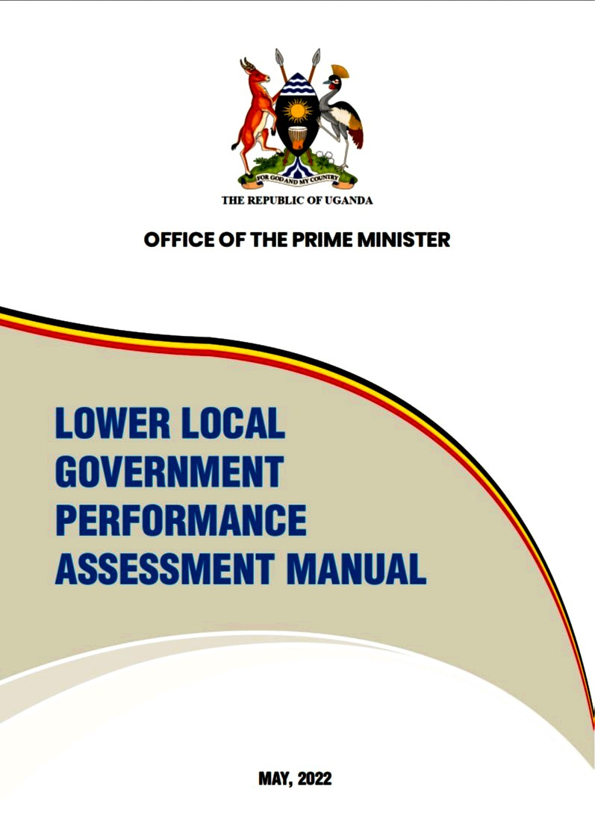
LOWER LOCAL GOVERNMENT PERFORMANCE ASSESSMENT 2023 RESULTS

Slide 16
Scores for LLGs under Makindye-Ssabagabo MC– LGMSD 2023
Rank | LLG | Score
1 | Bunamwaya Div | 74%
2 | Masajja Div | 85%
3 | Ndejje Div | 80%
4

Slide 17
Thank You!

